Slide 1
TCS – HP – Internal KT

Slide 2
Topics To Be Covered
DLP Means ?
Delta/Daily Load Propogation , where jobs were run in Job server (Standalone server) to feed data's into Stager App and web for Data validation before importing it into Live environment .
Categories Pre ETL ETL Post ETL

Slide 3
What Is Price load? Price Load takes care of loading the localized sku information, list price, offerprice and image information to the localized skus. This will be sourced from SAPSV Tables hosted in legacy database where MW team will be updating it on a daily basis.
Source : SAP-SV
Flow :
SAP-SV ➔PROD STAG ETL➔PROD STAG ETR
SAP to ETL --- > I068 (Middle ware Team)
ETL to ETR --- > DLP
Sql :
select count(*) from HPSAPSV_PRODUCT_PRICE_LIST where last_mod_time like '26-FEB-17' -->ETL
select pvalue from hp_batchjobparams where job_id=1008 and pname='price.sapsv.processedCount'; -->Stage
To check last update time in ETL : -
select max(ora_rowscn), scn_to_timestamp(max(ora_rowscn)) from HPSAPSV_PRODUCT_PRICE_LIST;
Contact in MW : SAPSV Team
Contact in SAP : suresh.mandapati@hp.com
Wait time : 60 mins
Log : Commerce80/log
Web & Application server usage : No
Impact : latest price wont get update in store

Slide 4
Job commands
Linux Environment
Go to /opt/apps/PDHDataLoad/bin directory:
nohup sh PriceLoad.sh HP-ROW.NA-G1 MANUAL &
or Go to /opt/apps/IBM/WebSphere/CommerceServer80/bin directory
nohup sh dataload.sh /opt/apps/PDHDataLoad/config/Price/wc-dataload.xml -DdataloadParams="|pdhConfigPath=/opt/apps/PDHDataLoad/config/WCAdapter,locale=en_US,jobContext=HP-ROW.NA-G1" -DstoreIdentifier="HP_Global_CAS" -DcatalogIdentifier="HP_Global_CAS" &
Running Full load
Only Catentry attributes subjob in PriceLoad can be handled for delta or full load cases and rest all subjobs are running in full load mode.
Update below two parameters in hp_batchjobparams
price.sapsv.catentryAttr.processedDateFromI19, price.sapsv.catentryAttr.processedDateFromTIBCO for PriceLoad job_id as 01-JAN-01.

Slide 5
Attribute Dictionary Master Data Load
Description Loads the attribute definitions to WCS by reading the file attr_en_US.properties in the path: PDHDataLoad\config\WCAdapter\mockds\data\modules\price\attrdict.
Customised Files AttributeDictionaryDataReader, AttrDictDataLoadHelper & AttributeDictionaryMediator
Catentry Data Load
Description Loads the localized sku information from SAPSV Tables which gets populated through MW on daily basis.
Customised Files CatentryDataReader, CatentryDataLoadHelper & CatentryMediator
Catentry Attribute Dictionary Attributes Data Load
Description Loads relationship between catentry and attributes to WCS.
Customised Files CatentryAttrDataReader, CatentryAttrDataLoadHelper & CatentryAttrMediator
Eligible List price Data Load for US Eligible products (STO) from CORONA
Description Loads list price values to STO Produts in WCS at US_StoreList tradeposn container level. Currently this subjob is disabled as it is applicable after global pricing model is enabled.
Customised Files ListPriceDataReader & ListPriceDataLoadHelper
List price Data Load for US ELigible products from SAPSV Tables
Description Loads list price values to STO, PGC, VGC, 3PP and Promotional Gift cards in WCS at US_StoreList trade posn container level.
Customised Files ListPriceDataReader & ListPriceDataLoadHelper
Offer price Data Load
Description Loads offer price values to STO, PGC, VGC, 3PP and Promotional Gift cards in WCS at CG_epp,CG_epphp and US_Store ProductsPriceList tradeposn container levels.
Customised Files OfferPriceDataReader & OfferPriceDataLoadHelper
Attachment Relationship Catentry Data Load
Description Copies images data from base sku to localized sku.
Customised Files CatentryAttachmentsDataReader, CatentryAttachmentsDataLoadHelper & CatentryAttachmentMediator

Slide 6
What is PST ? It is functionality to bring price tag of specific individual catentries to front end rather displaying it in Cart page .
To display PST price
Controller command for all customer segment.
CG_gs
CG_epp
CG_epphp
CG_gsmpr
CG_eppmpr
CG_hpeppmpr
select count(catentry_id) from xcatentdisprice where lastupdate like '23-MAR-16%';
Web & Application server usage : Yes
Impact : PST price wont display in store
Ex :
wget "http://glbecomtran-ext-uat1.houston.hp.com/webapp/wcs/stores/servlet/PriceStrikeSchedularCmd?storeId=10151&catalogID=10051&langId=-1&groupNames=CG_mpr_gs&flagForTommorow=1
Post PST Validation By Apps Team

Slide 7
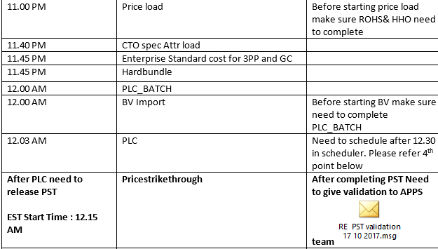
Flow Between Price Load And PST

Slide 8
Job Commands
Linux Environment
Go to /opt/apps/PDHDataLoad/bin directory:
nohup sh PriceStrikeThrough.sh HP-ROW.NA-G1 MANUAL &
For logs Go to /opt/apps/IBM/WebSphere/CommerceServer80/logs directory
Log type ex- "HPPriceStrikeThrough.log.20180308.0806"

Slide 9
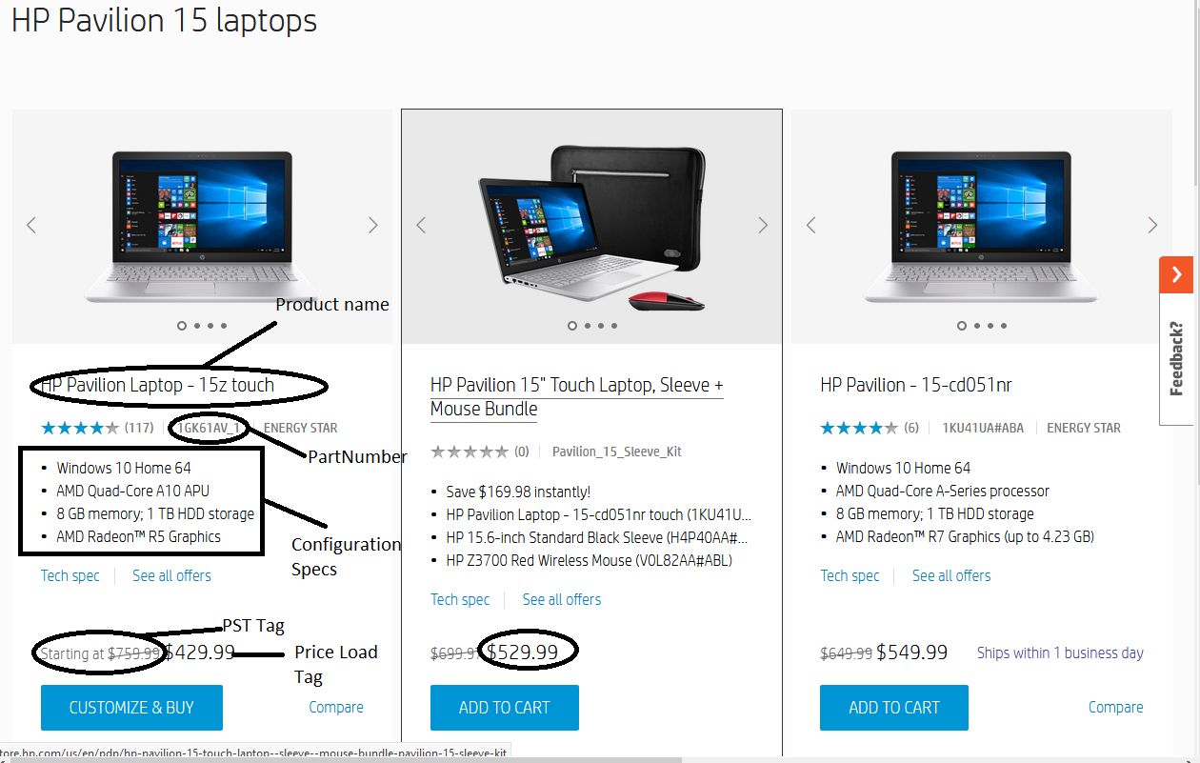
Example from store.hp.com

Slide 10
Issues Faced
Price Load job – MW fails to load HPSAPSV_PRODUCT_PRICE_LIST and an IM is raised.
PST Issue – Dependency files count will be static , so we will engage with DLP team .
Most of the issues will be with Private store recently we faced and XCATENDIS--- Table will be updated likely.

Slide 11

Thirst for Knowledge begins

